Slide 1
Twitter sentiment Analysis in Healthcare as a binary classification problem Team 8 COMP4103-BIG DATA
© University of Nottingham (2021)

Slide 2
INTRODUCTION & MOTIVATION
Social media platforms allow people to express themselves on a variety of issues, including healthcare.​
As a result, a substantial amount of text data is generated, which can be evaluated to determine how the public feels about this topic. ​
Our study focuses on assessing and analysing public opinion about healthcare, which will help us better understand and identify problems in the system.​
This is accomplished by contrasting the sentiment analysis performance of Naive Bayes and Decision tree.​
Each processed tweet's sentiments will be predicted by the classification models, and their performance will be evaluated using the F1 score as a comparison of precision and recall.​

Slide 3
INTRODUCTION & MOTIVATION
The algorithms focused on in this paper are Naïve Bayes and Decision Trees.
The Naïve Bayes algorithm is quick, performs better than other models, and needs a lot less training data.
Decision tree does not require data normalisation, and missing values in the data have no effect on the decision tree building process.
In comparison to other algorithms, decision trees need less effort for data preparation during pre-processing.
The dataset used in this paper is a twitter API data collected in 2015.
The dataset consists of health data from over 16 major health news agencies including BBC,CNN and NYT.

Slide 4
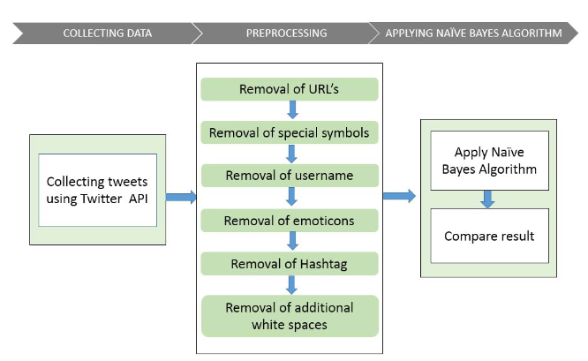
Core-related work
Words and phrases bespeak the perspectives of people about products, services, governments and events on social media. Extricating positive or negative polarities from social media text denominates task of sentiment analysis in the field of natural language processing
In our case study, the health tweets are classified into one of some predetermined categories mainly (Diseases, Medical Treatments, Biological Analysis, Medications, Epidemiology, and Environment) with over 600 tweets collected. For this goal, we employed Decision Tree (ID3), KNN, and SMO classifiers in order to extract opinion targets. Furthermore, the ensemble methods or combination methods (bagging, boosting, and stacking) were used to improve the multi-class accuracy.

Slide 5
Methodology
1. Data Preparation:
Loading and making single data frame file.
Preprocessing the data by transforming the time column and selecting useful features.
2. Data Preprocessing:
Tokenizing, stemming, lemmatizing, removing punctuation, and transforming the content column lowercase.
Applying sentiment analysis using an analyzer to obtain sentiment labels.
3. Bag-of-Words Transformation:
Transforming the pre-processed text column into a bag-of-words format.
4. Feature Visualization:
Visualizing features against label counts to gain insights into the data distribution. Further splitting the data in training and testing data.
5. Machine Learning Pipelines and Model Evaluation:
Creating separate machine learning pipelines for training the models. Generating predictions on the test set and evaluating their performance against the test labels to assess the accuracy of the sentiment analysis.

Slide 6
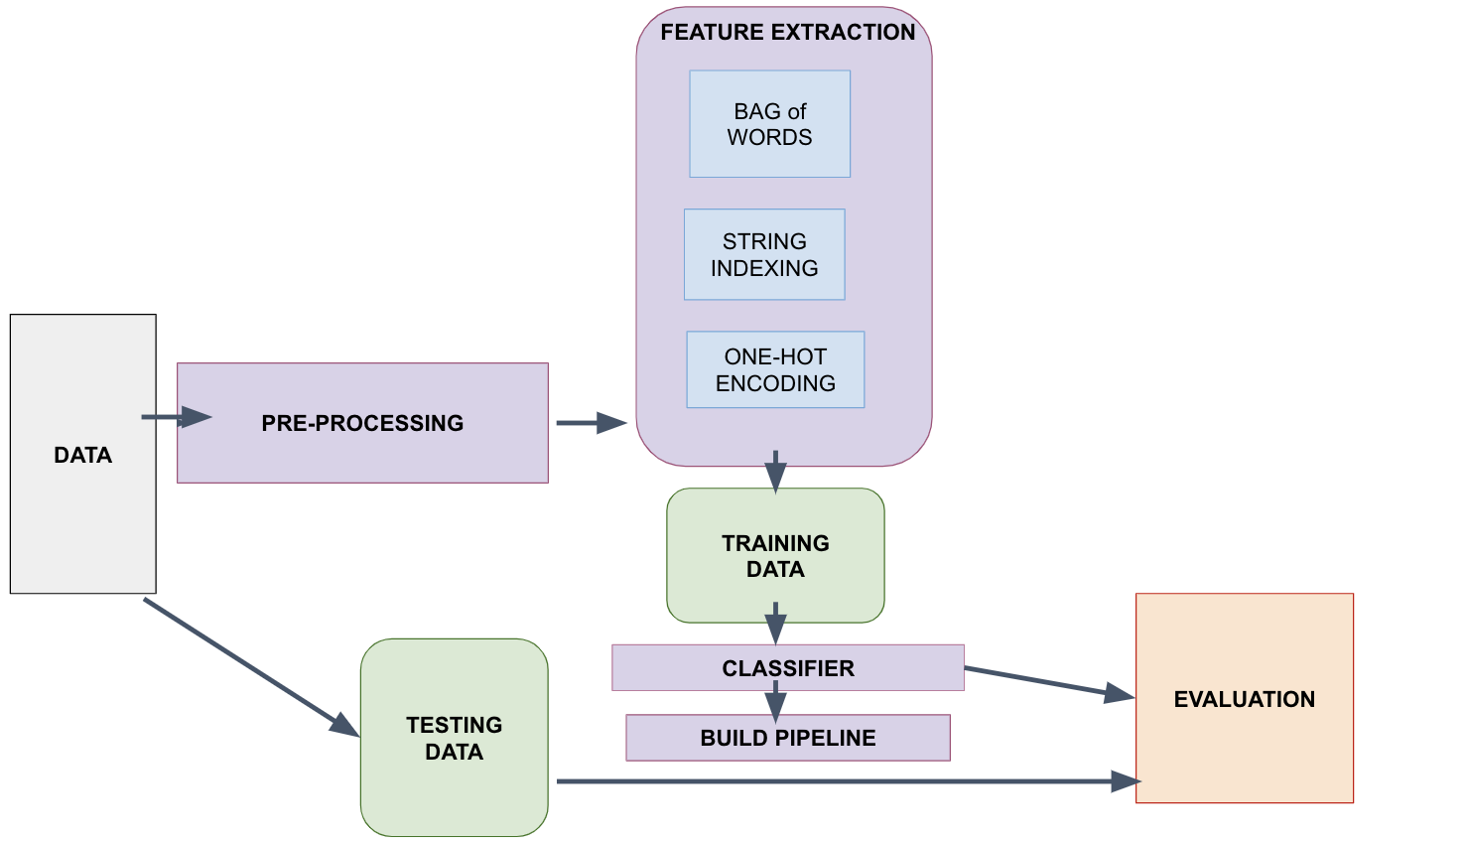
Work flow:

Slide 7





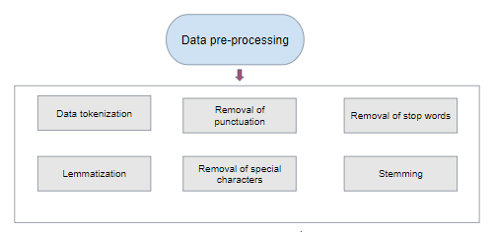
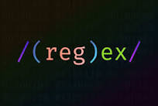
Experimental Setup

Slide 8
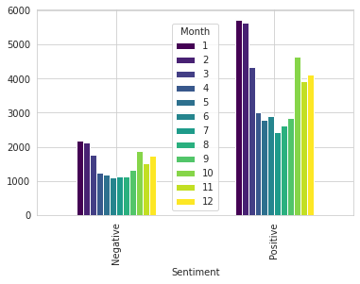
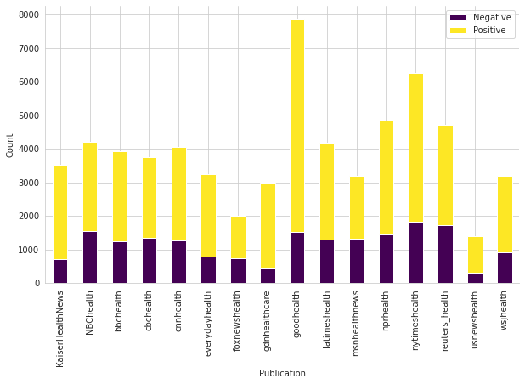
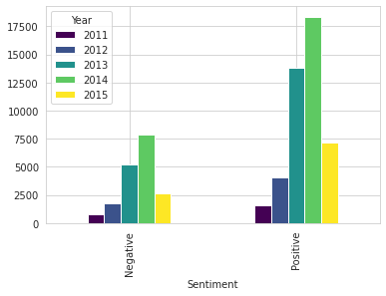
Experimental Setup Continued

Slide 9

Experimental Setup Continued
Classifiers used to create the model
Naïve Bayes Classifier
Decision Tree Classifier
Machine learning pipeline consists:
String Indexers
Encoders
Vector assembler
Cross-validator
Naïve bayes model uses Multinominal probability distribution to model frequency distribution of features
Decision tree model requires specification of depth of decision tree and maximum number of bins to use to discretize continuous features in dataset
Both model use parameter grids to search optimal hyperparameters provided for Cross-validation with 5 folds to reduce overfitting and include the
evaluator with F1 score metric for each field.

Slide 10
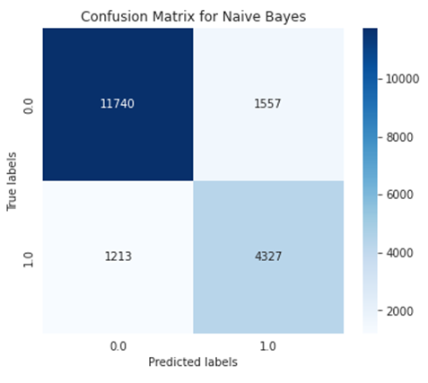
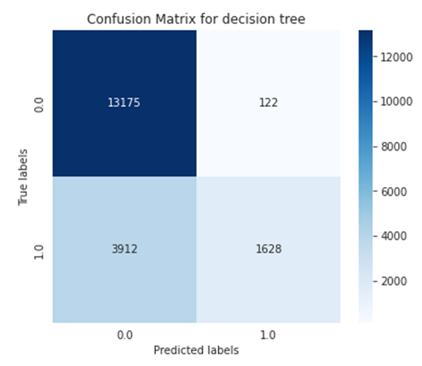
Results
Multinomial Naïve Bayes (MNB):
F1 score = 0.854
Takes 80 seconds to train
Decision Tree:
F1 score = 0.743
Takes 13 minutes to train (~10x as long as Bayes)
MNB predictions contained:
11737 TPs, 4328 TNs, 1212 FPs, 1560 FNs
Decision Tree predictions contained:
13175 TPs, 1626 TNs, 3914 FPs, 122 FNs

Slide 11
Future Improvements
Decision tree unsuitable for this type of problem compared to other algorithms
Multinomial Naïve Bayes very well-suited to text classification
Evolution of DT may improve accuracy and efficiency issues – BFTree
Best-First Tree prioritizes promising branches – informative features/instances
Designed to be robust to noisy data – pruning
Builds on traditional DT through scalability – suitability for big data

Slide 12
Conclusions
Multinomial Naïve Bayes:
Highly efficient
High accuracy through F1 score
Showed no bias towards either sentiment label
Generalized well to new data
Decision Tree:
Easy to interpret
Inefficient, even after optimising parameters
Less accurate than Bayes
Biased towards positive sentiment predictions

